Slide 1
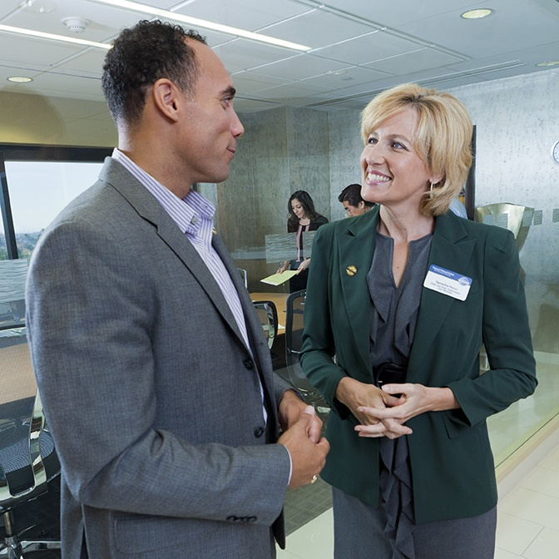
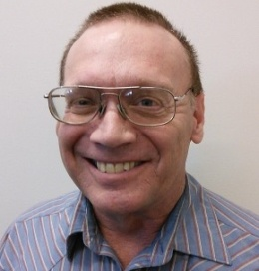
New Club Mentor & Sponsor
For More Information
Build rapport with club members.
New Club Sponsors
You work with a new club for a short period of time. A Sponsor is a member who Generates interest and enthusiasm for the new club. Helps charter a new club with filling out paperwork.
A Sponsor submits all chartering paperwork to World Headquarters.
Resources…
Help organize officer team.
Helps recruits members fostering a membership-building culture.
Maintain at least 20 members.
Strive to gain new members.
Regis Zweigart, DTM
District 19
Mentoring & Sponsor Chair
Phone: 319-721-1265
Email: zweigart@netins.net
DISTRICT 19

Slide 2
Toastmasters Teamwork
Give a man a fish and you feed him for a day. Teach a man to fish and you feed him for a lifetime.
New Club Mentors
Up to two new Club Mentors are appointed by District Directors or Club Growth Directors. Alternately, District Directors or Club Growth Directors can submit Mentors’
Why Be A Mentor
Gives guidance, support, and reassurance showing mentee’s goals and efforts are worth while
Gives practical advice from someone who understands the Toastmaster program
Increase team work skills and prove yourself as a valuable leader.
Self satisfaction. There is a sense of pride when you see a new member successfully advance in educational awards.
Earn credit toward ALS award
Invest in the future of Toastmasters.
“People don’t care about how much you know until they know how much you care”
- John C. Maxwell
What a will a Club Mentor do?
Guide and build rapport with club leaders and members.
Ensure the club is strong and fully functional with an agenda.
Confirm officers understand their duties and have the tools they need to perform them.
Enables the club to achieve goals.
Instills enthusiasm, fidelity and a sense of responsibility for the club’s future.
Necessary Skills
Ability to listen
Willingness to learn
Desire to be with smiling happy people and have FUN helping people!!
In addition to the materials sent by Toastmasters and the resources available online you will receive additional training, support, and incentives from the Club Growth Director and the District 19 Mentor & Sponsor Chair. Plus, monthly conference calls for mentors and sponsors.
What a Club Mentor Avoids
Tell the club what they should do
Fix problems
Change the club culture or dynamics
Take on others’ responsibilities

